Slide 1
Olist Store Analysis
An E-Commerce Project
Presentation by Group-6
Project Members –
Ms. Vaishnavi Laxmikant Joshi
Mrs. Minku Raj
Vijay tammanna siddhi
Ms.Padmini.R.Bevinakatti

Slide 2

Agenda
Introduction
Overview
KPI’s
Dashboards
Insights & Recommendations
Conclusion

Slide 3


Overview
The Olist Store Analysis project aims to analyze customer purchasing patterns and payment statistics on an E-commerce platform, Olist.
This project covers several key performance indicators (KPIs) such as weekday Vs weekend sales, payment statistics ,delivery time and customer behavior.
The analysis is based on nine CSV files, which are cleaned and manipulated to extract valuable insights.

Slide 4
KPI’s
Weekday Vs Weekend (order_purchase_timestamp) Payment Statistics
Number of Orders with review score 5 and payment type as credit card.
Average number of days taken for order_delivered_customer_date for pet_shop
Average price and payment values from customers of sao paulo city
Relationship between shipping days order_delivered_customer_date - order_purchase_timestamp) Vs review scores

Slide 5
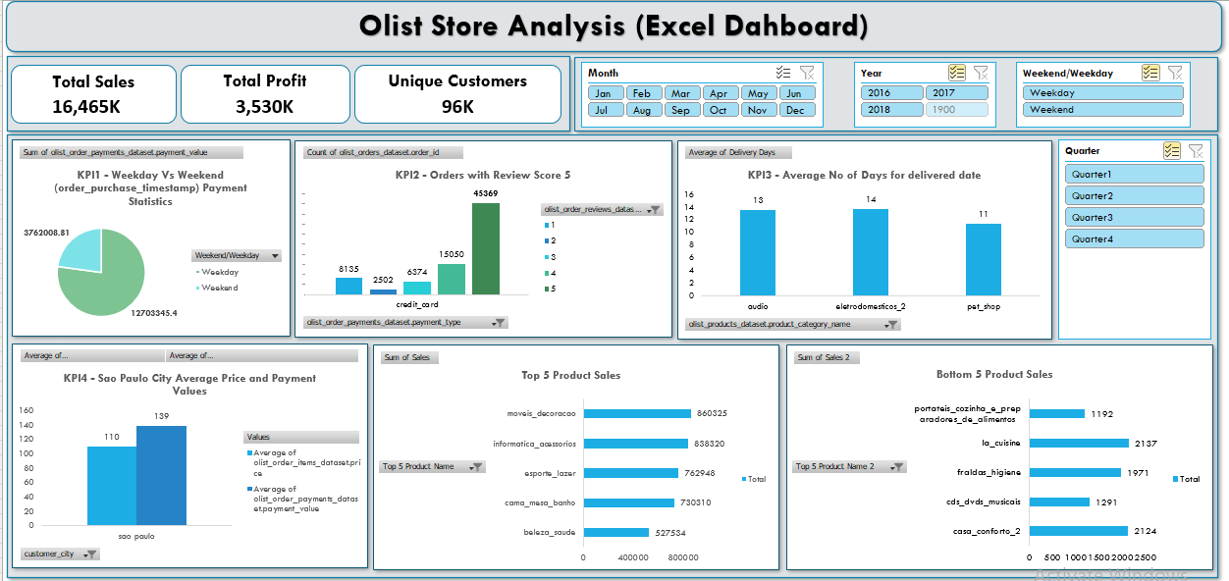
Excel Dashboard

Slide 6
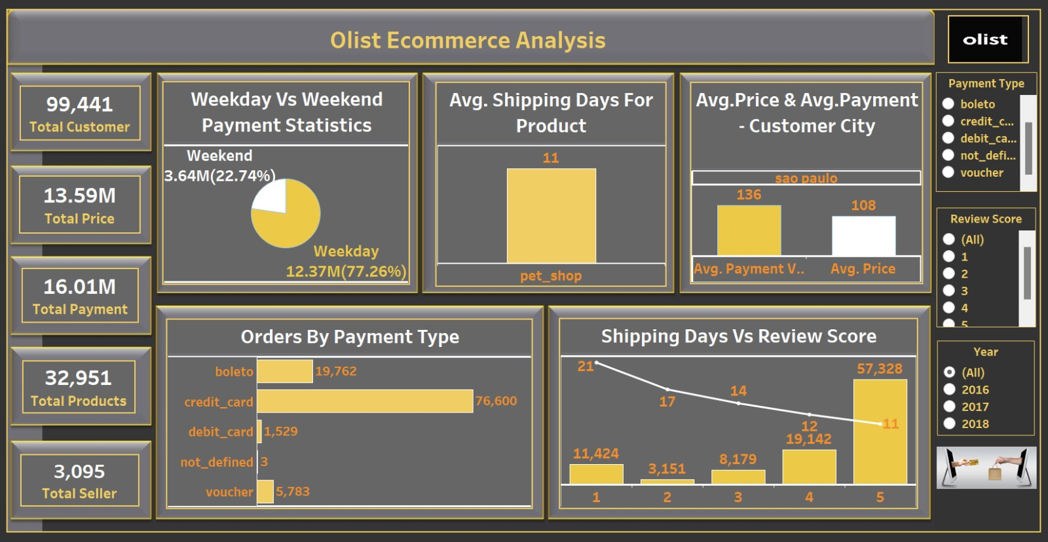
Tableau Dashboard

Slide 7
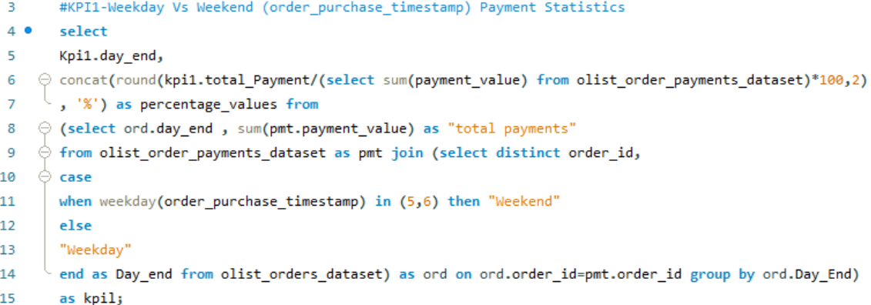
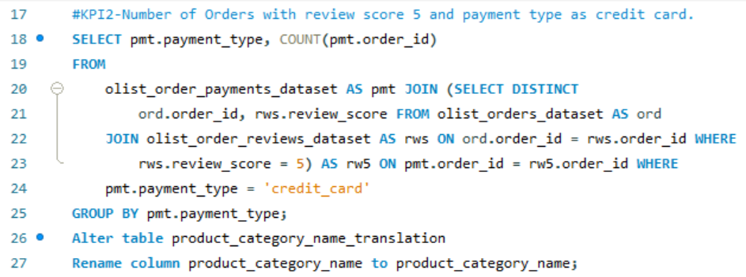
SQL Queries
KPI1 : The analysis of payment statistics based on weekday Vs weekend provides the understanding of the buying behavior of customers.
KPI2 : This KPI analyses the number of order with of 5 and payment type as credit card.
This helps in understanding customers satisfaction levels and payment preferences.
Olist can use this information to identify satisfied customers and encourage them to make repeat purchases.

Slide 8
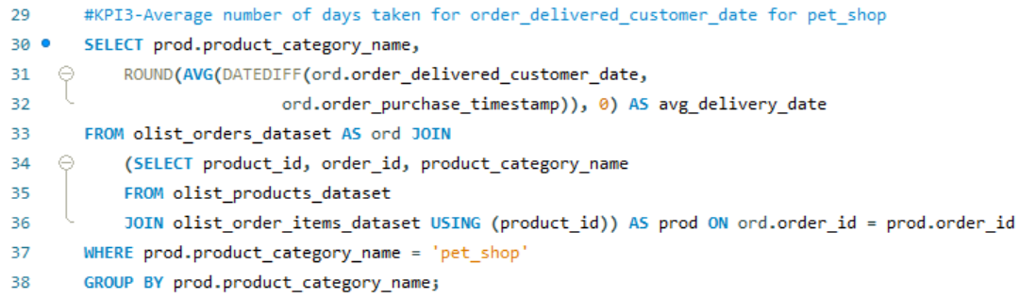
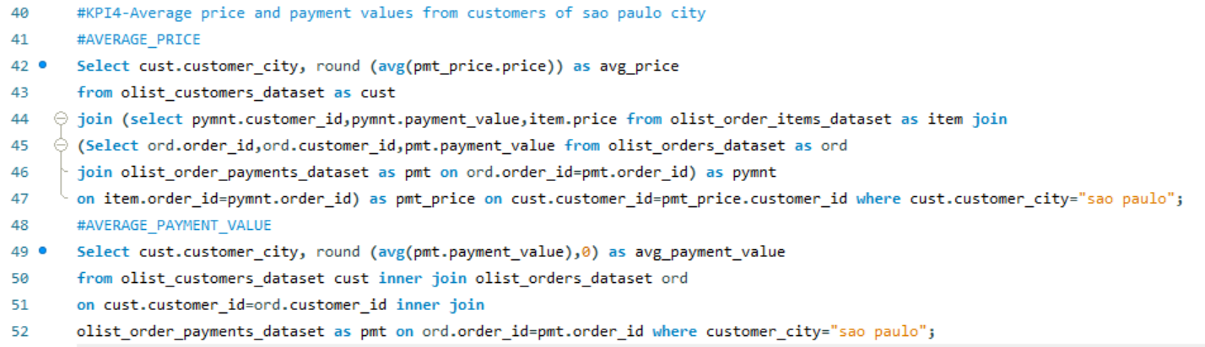
SQL Queries
KPI3 : This KPI analyzes the average number of days taken for order_delivered_customer_date for pet_shop,
It helps Olist in identifying areas where they can improve time and maintain customer satisfaction.
KPI4 : The analysis of average price and payment values from customers of sao paulo city helps in understanding the spending patterns of customers in this region.
It also helps Olist in identifying high-value customers and creating targeted marketing campaigns.

Slide 9
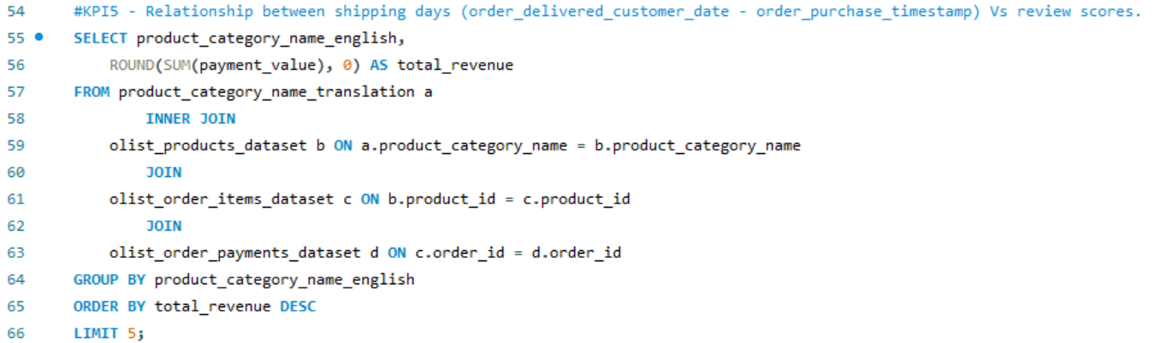
SQL Queries
KPI5 : This KPI evaluates the correlation between shipping duration and review rating.
It helps to understand delivery time and customer satisfaction.
Olist can use this information to improve shipping and delivery processes to reduce transit times across all review score categories.

Slide 10
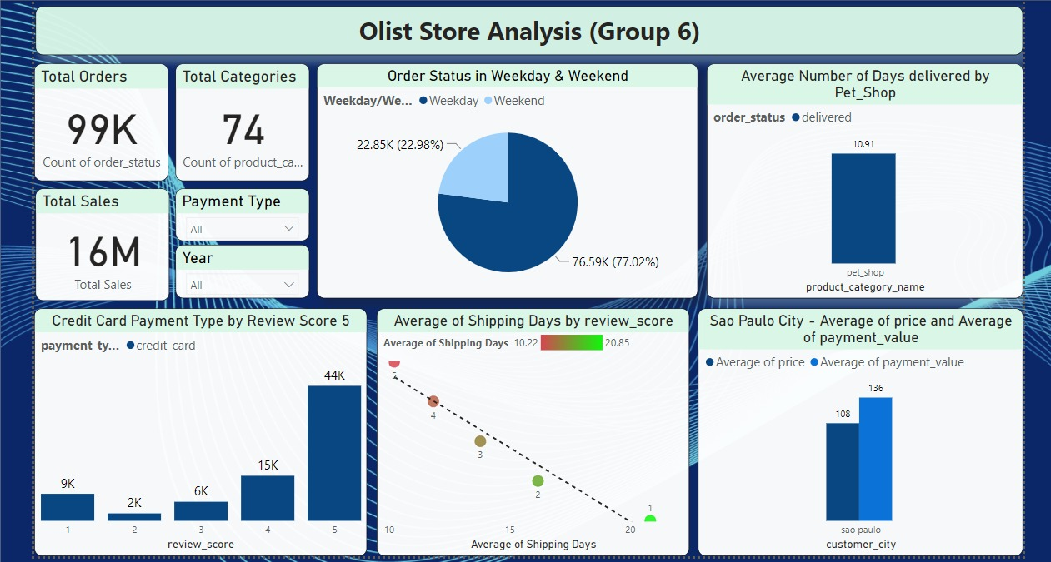
Power BI Dashboard

Slide 11
Insights
According to the data, Olist E-commerce has about 99,440 orders. with about 89,940 orders being delivered, the company has a 90% delivery success rate.
average product rating is 4.09 stars, with product categories going as high as 4.67 stars and as low as 2.5 stars.1 star
Reviews are on third place in the review score distribution ranking, which likely indicates that there could be problems with product quality in some product categories.
Delivery performance could also influence review scores and success rate could certainly be improved.
Insights from this analysis can help in making business decisions, such as focusing on products that customers are interested in, improving product and service quality, and optimizing marketing in provinces with high total sales .
In addition, this analysis also provides an overview of customer consumption trends patterns that can be used to direct further business strategies.

Slide 12
Conclusion
Studying how customers behave and pay for things using the Olist store Analysis project gives us useful information. By looking at these details, Olist can find ways to make things better and create ads that target specific groups of people .
As a data analyst, I have used excel and power bi to clean and manipulate the dataset and create meaningful visualizations, this project serves as a great example of how data analysis can help businesses make informed decisions.

Slide 13

Thank You.

